Slide 1
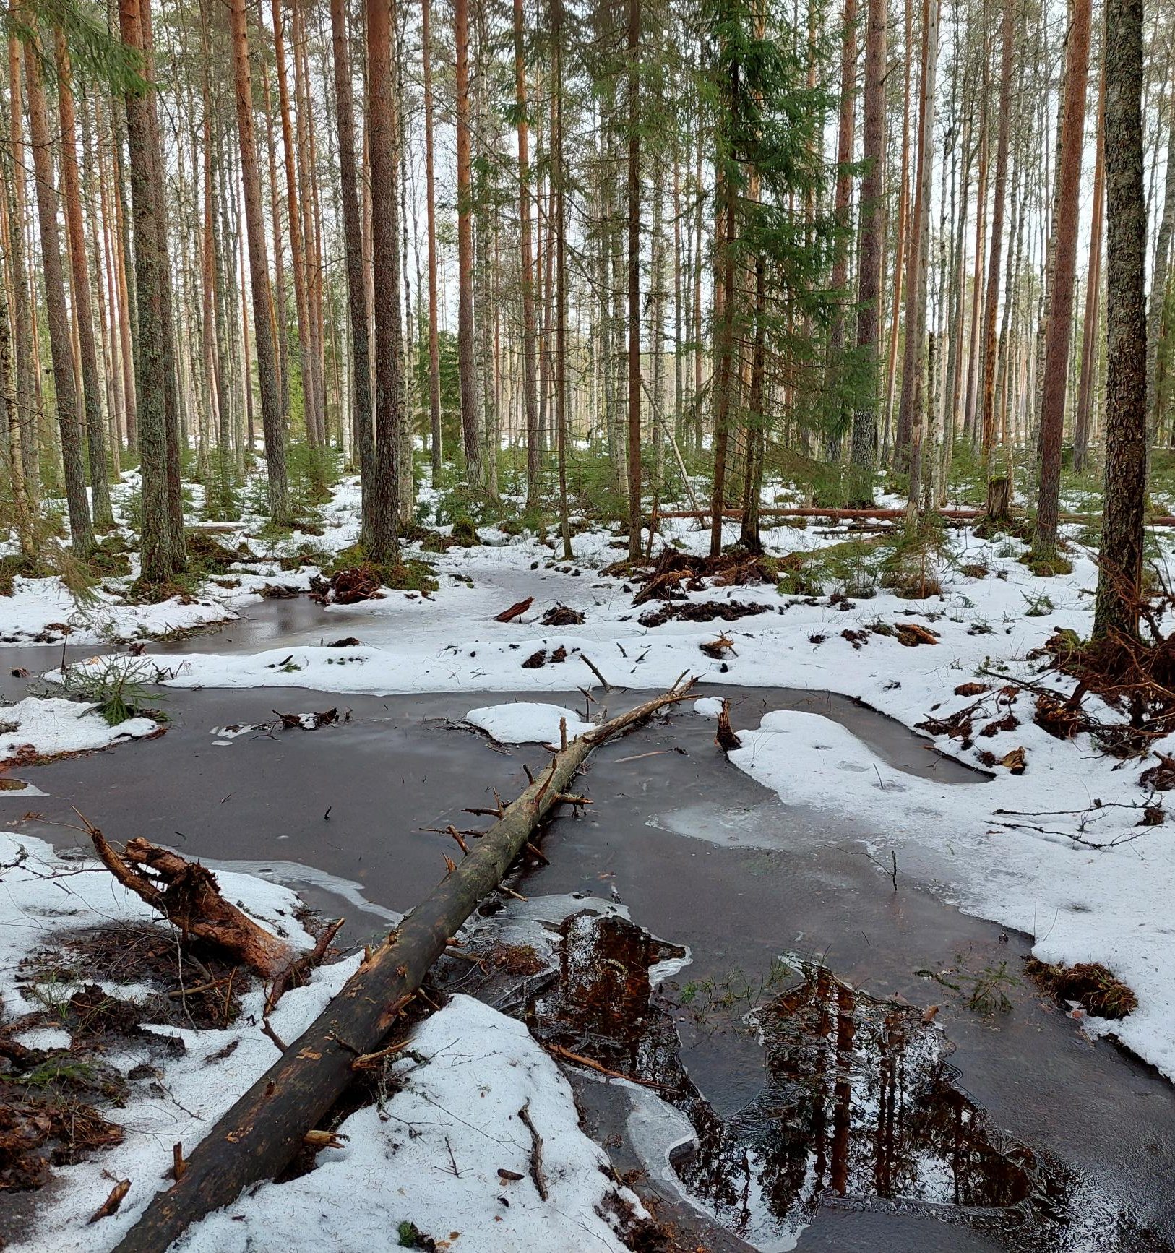
Rewetting drained boreal peatland forests does not mitigate climate warming in 21st century
Samuli Launiainen, Paavo Ojanen, Anssi Ahtikoski, Janne Rinne, Hannu Hökkä 5.3.2024
Notes:
Note: If the image placeholder rotates when placing an image, do this:
1) Undo
2) Open the image in any image processing program (Paint etc.)
3) Save the image
3) Place the image again to your presentation
This problem occasionally happened when inserting a vertical image

Slide 2
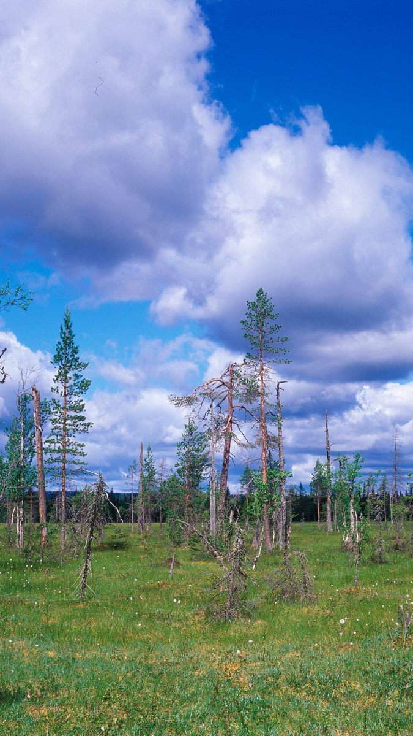
Content
Atmospheric radiative forcing
Methods to estimate climate-impact of peatland use change
Does rewetting drained peatland forests warm or cool the climate?
Should we rewet?
Photos: Paavo Ojanen & Luke media bank

Slide 3
Atmospheric radiative forcing changes
Peatland use change affects how solar radiation is absorbed in the Earth system

Slide 4
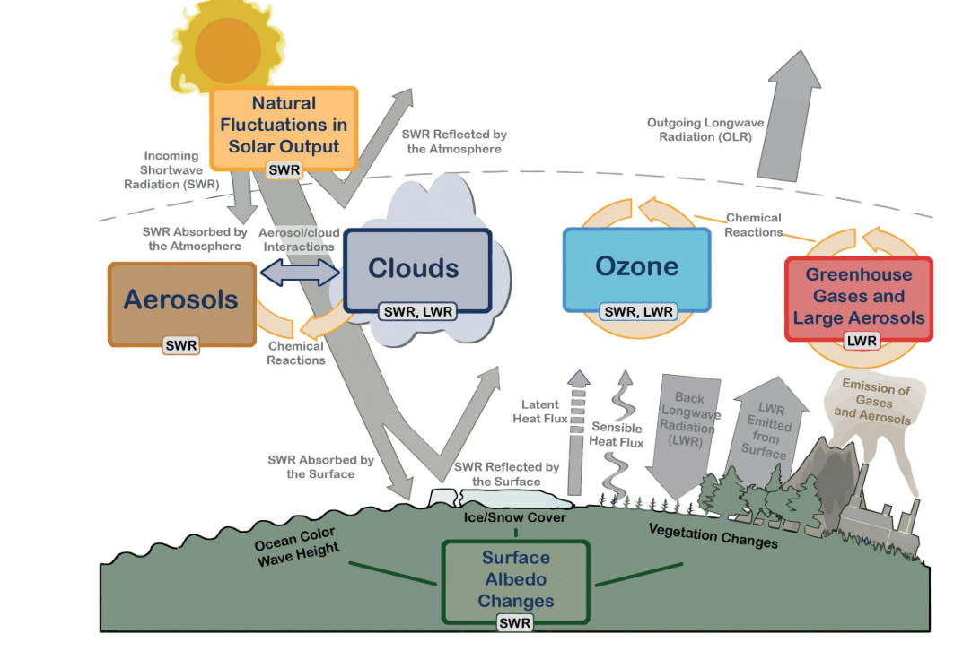
Radiative forcing (RF)
Measures how Earth’s energy budget changes due to e.g. land-use change
Elevated atm. GHG concentrations increase absorption of thermal radiation
Change in peatland structure can affect albedo
Metric to compare climate impacts from multiple causes: several GHG’s, albedo, …
We compare two alternative land-use cases: continued forestry use and restoration

Slide 5
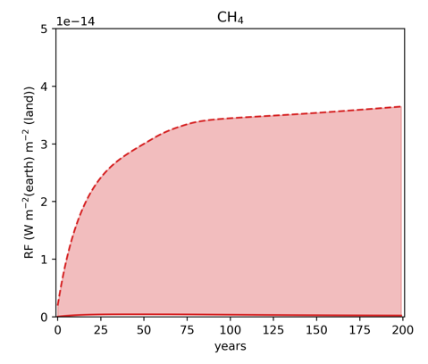
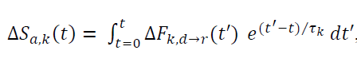
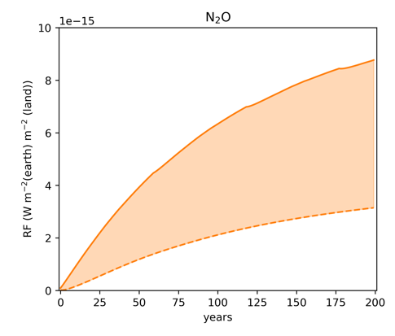
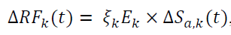
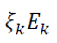
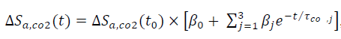
Radiative forcing of gas k
restored
Change in annual surface flux of gas k creates cumulative change in atm. concentration of gas k over time t:
Change in atm. concentration of k leads to change in RF:
depict radiative efficiency of gas k
forestry
forestry
restored

Slide 6
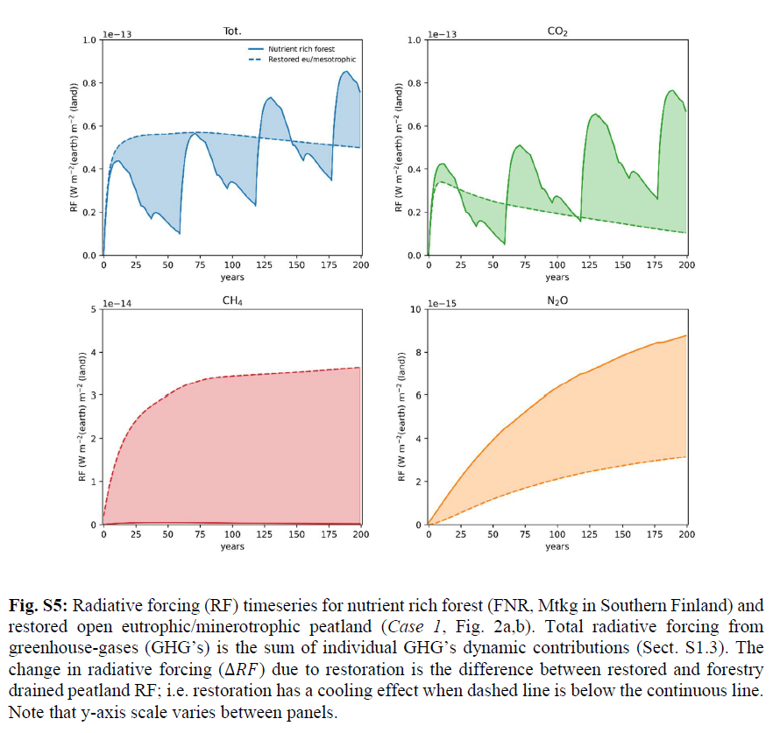
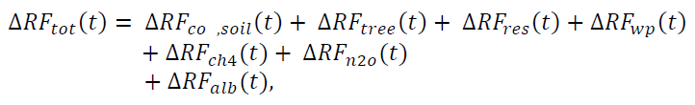
RF’s are additive
forestry
restored
Time-varying contribution of
Different GHG’s
(eco)system components
Can climate impact of peatland use be determined based on CO₂ only?
restored
forestry
restored
forestry

Slide 7
Bookkeeping model and boundaries
We compute change in system CO₂ storage and CO₂, CH₄ and N₂O fluxes over time (forestry vs. restoration). These change atmospheric GHG concentrations and RF’s.
”Use what is out there, in a clever way.”

Slide 8
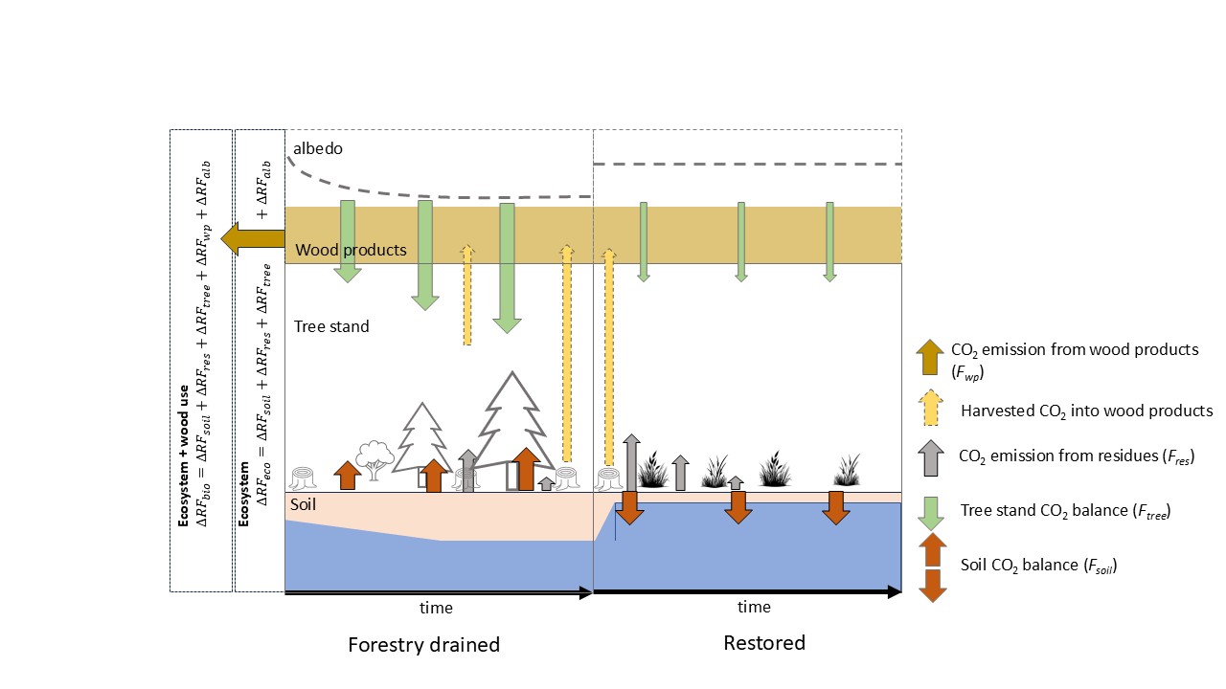
CO₂ budget
CO₂ flux between system and the atmosphere
Growth simulator
biomass C → NPP
Harvests → wood products, residues
Vol.
Empirical soil CO₂ balance = f(Vol.)
System boundaries
On-site (ecosystem)
On-site + wood use
CO₂ storage in the system

Slide 9
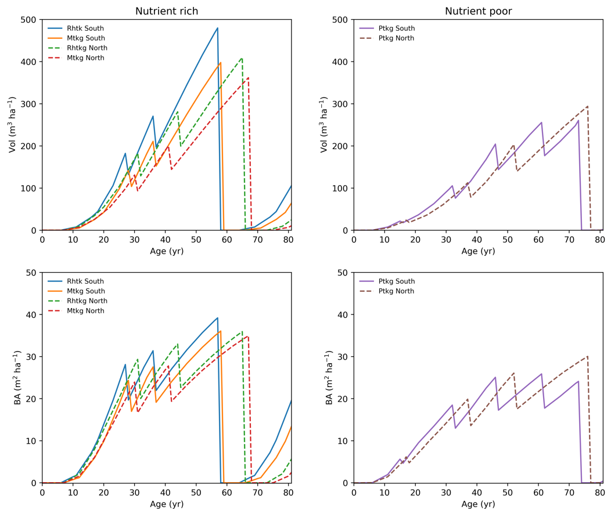
Tree stand growth and CO₂ uptake
Motti growth simulator (Hynynen et al, 2005)
BAU, Southern (Tampere) and Northern (Oulu) Finland
Nutrient-rich peatlands (FNR)
Herb-rich (Rhtkg), mesotrophic Vaccinium myrtillus-type (Mtkg)
Rotation ca. 58 / 68 yr, 2 thinnings
Nutrient-poor peatlands (FNP)
Oligotrophic V. vitis-idaea type (Ptkg)
Rotation ca. 75 yr, 2-3 thinnings
Annual tree NPP estimated from predicted biomass change
Understory NPP omitted

Slide 10
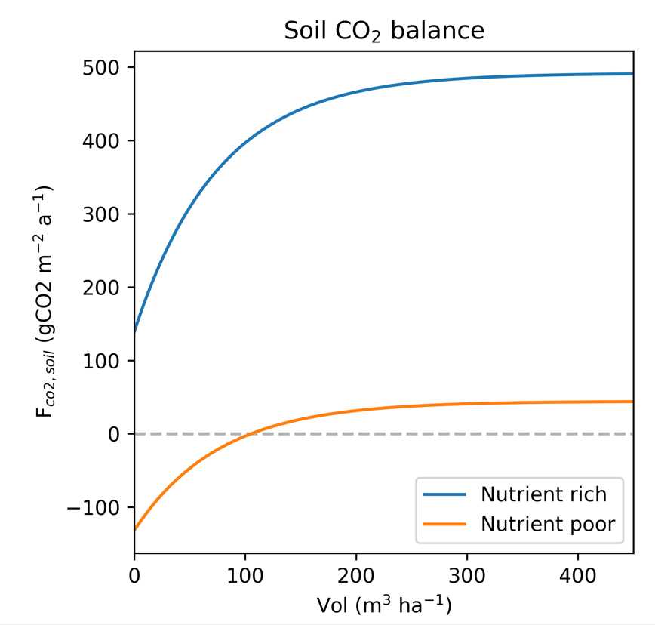
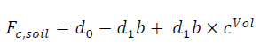
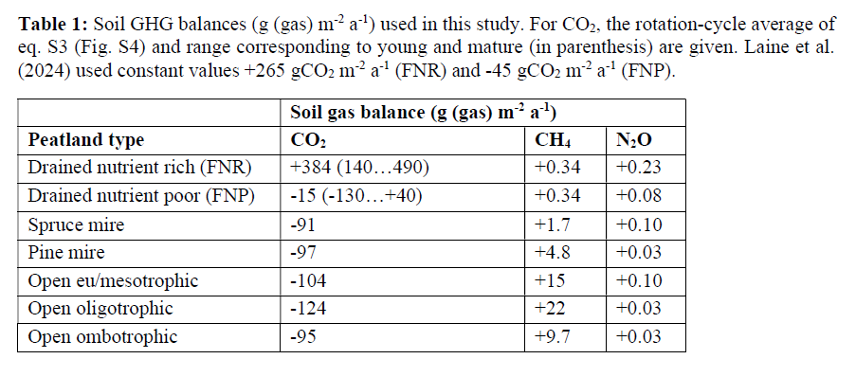
Soil CO₂, CH₄ and N₂O balance
Forest soil CO₂ balance: f(Vol, fertility)
Laine et al. 2024 give overview of annual net soil gas balances
We assume CH₄ and N₂O fluxes from forest & restored, and CO₂ flux from restored, are constant in time (Table 1)
Sink Source
Based on:
F_{c,soil} = f(WT, fertility), Ojanen & Minkkinen (2019)
WT = f(Vol), Sarkkola et al. (2010)

Slide 11
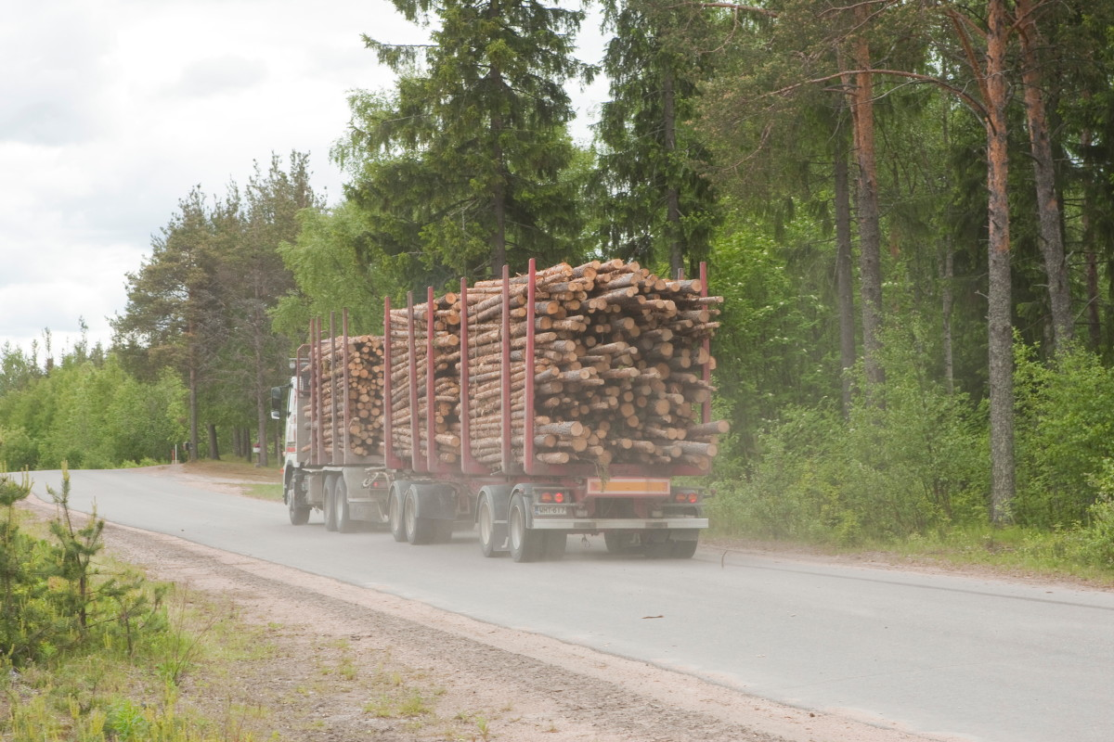
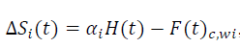
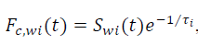
Wood products and residue pools
Wood products (removed from site)
Short-term 2 yr, long-term 20 yr.
Allocation based on timber fraction x saw yield
Residues 3 pools (left to the site)
Foliage 3 yr
FWD 7 yr
CWD forestry (stumps, coarse roots) 30 yr
CWD (restored) 300 yr (anoxic conditions)
Filled from harvests, decay exponentially
CO₂ storage change
CO₂ flux to atm.

Slide 12
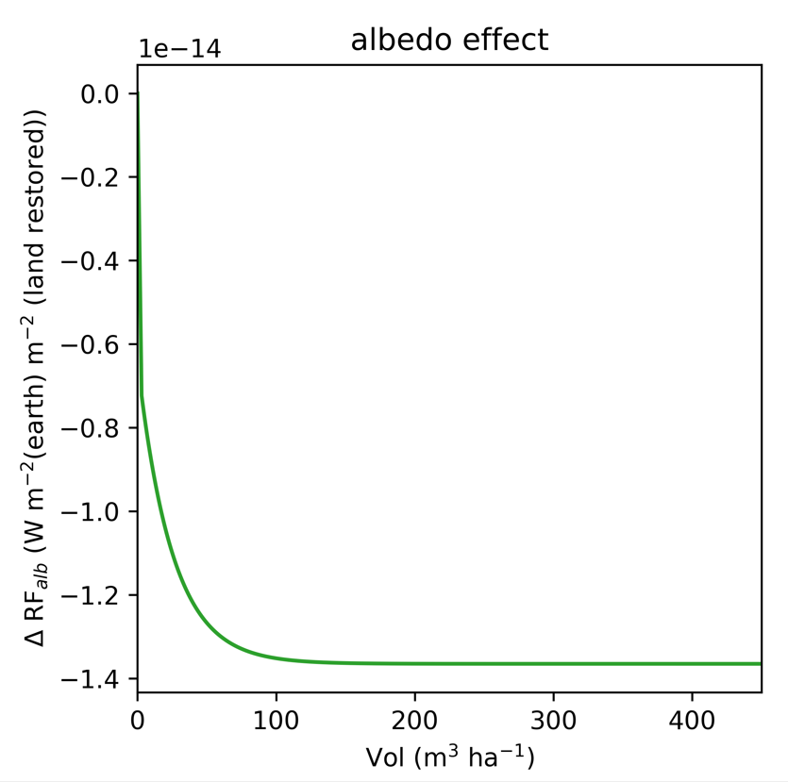
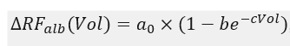
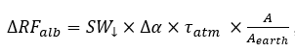
ΔRF from albedo change
Forest albedo < open peatland albedo
Difference largest in mature (high Vol.) stands during wintertime
Albedo RF depends on local albedo change, surface area & solar radiation
On annual scale - a rough approximation:
We use literature to parameterize ΔRF_{alb} as function of stand Vol. in Southern Finland.
”Restoring to open peatland increases albedo and contributes to cooling (ΔRF_{alb} <0). The effect saturates with stand Vol.”
Lohila et a. 2010 JGR; Peräkylä et al.m 2025 BG

Slide 13
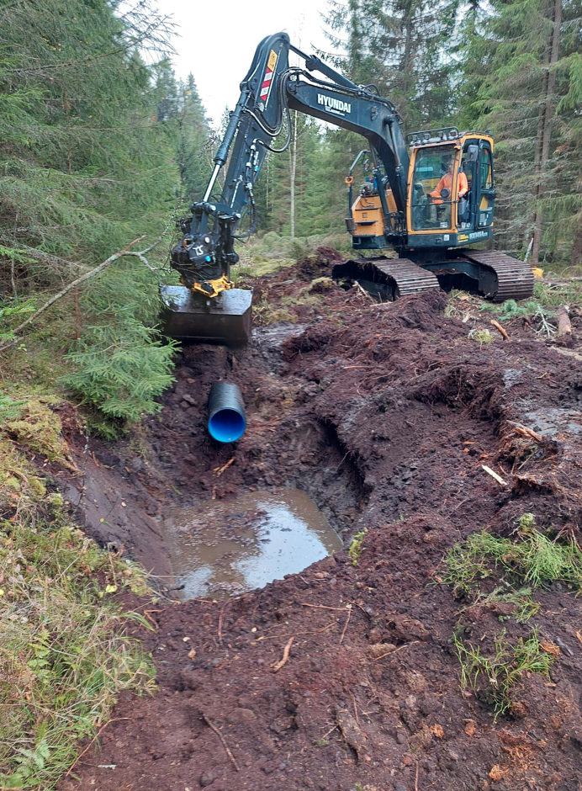
Does restoration warm or cool the climate?
Some case-examples

Slide 14
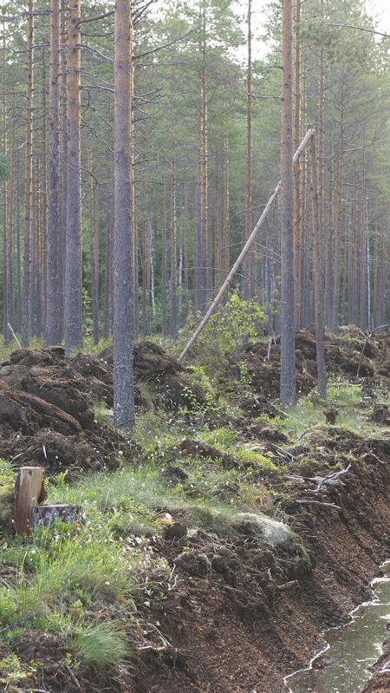
Comparing restoration to continued forestry
Continued forestry for next 200 years as in the past
Rewetting and restoration either to: i) an open peatland, ii) tree-covered mire
Restoration takes place after clear-cutting at end of rotation
Harvest residues and wood products ’decompose’ in restoration-scenario, while are periodically replenished in continued forestry scenario
We focus on change in total radiative forcing and its components

Slide 15
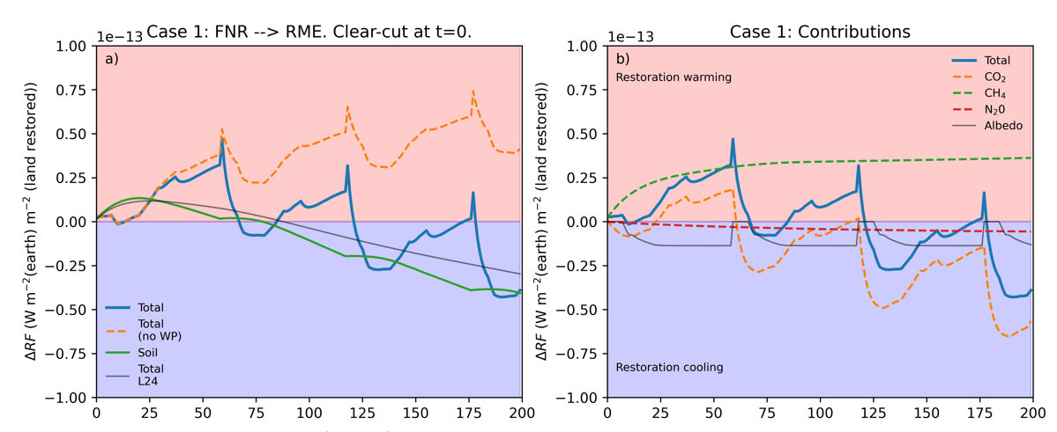
Nutrient-rich forest to open mesotrophic fen
Net warming over 2 first rotations, mainly due to increased CH₄ emissions & strong tree CO₂ sink
Albedo-change provide cooling
Very different outcomes if only:
CO₂ effect is considered
part of system considered (soil, no wood products, …)
Warming effect of rewetting is the stronger the more productive stand is restored

Slide 16
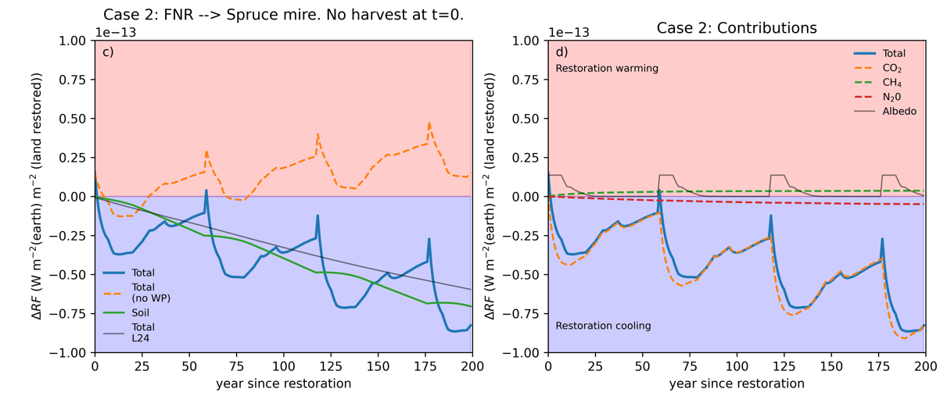
Restore nutrient rich stand to tree-covered mire
Net cooling IF tree stand CO₂ storage is preserved after restoration
Albedo-effect is opposite to Case 1
Small impact of CH₄ and N₂O as fluxes do not change much
What happens for climate benefits if restoration does not affect wood demand?

Slide 17
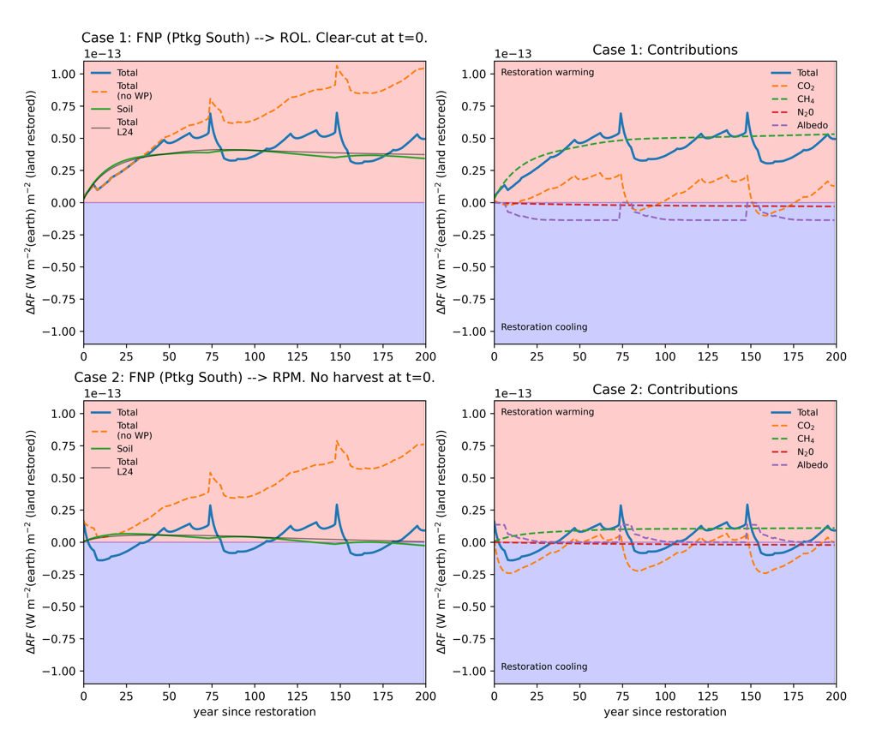
Restoring nutrient poor stands
Restoring to open peatland
Persistent net warming, due to CH₄ emissions
Soil (CH₄ + CO₂) balance contributes to warming
Restoring to pine mire
Climate-neutral if tree CO₂ storage preserved
Small contribution from CH₄

Slide 18
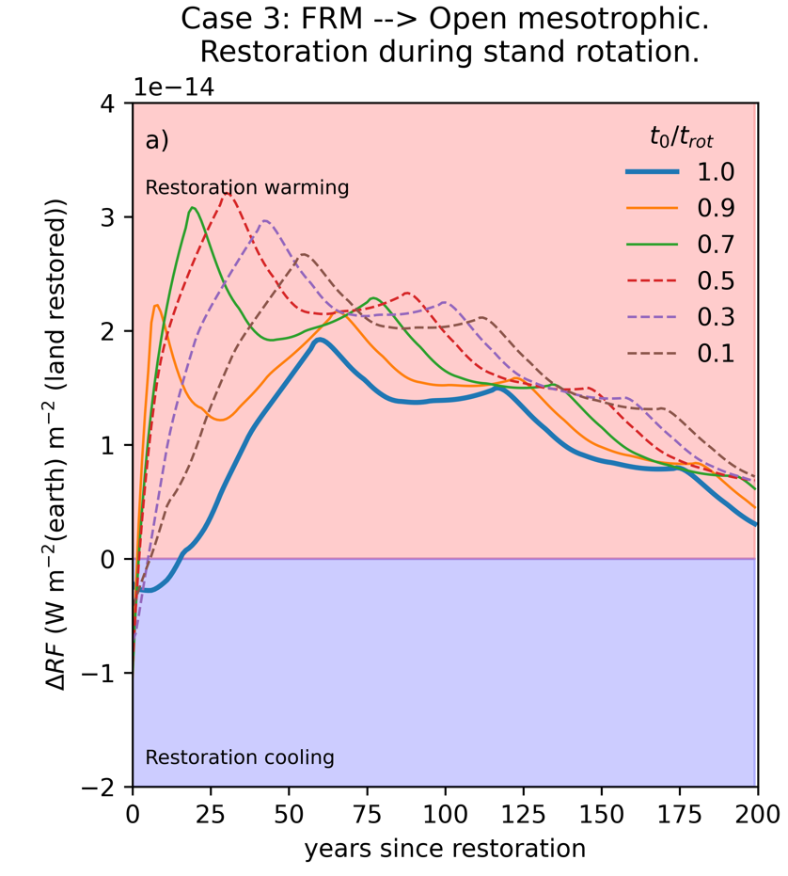
What if one restores during rotation cycle?
Nutrient rich stand → open mesotrophic fen
Reweting by clear-cutting during rotation period (t_{rot})
Restore large stand late in rotation
earlier large emissions from residues & wood products
Restore small stand early in rotation:
small emissions from residues & wood products but large ’gap’ due to lost growth
Best to restore at rotation end – but not always practicable

Slide 19
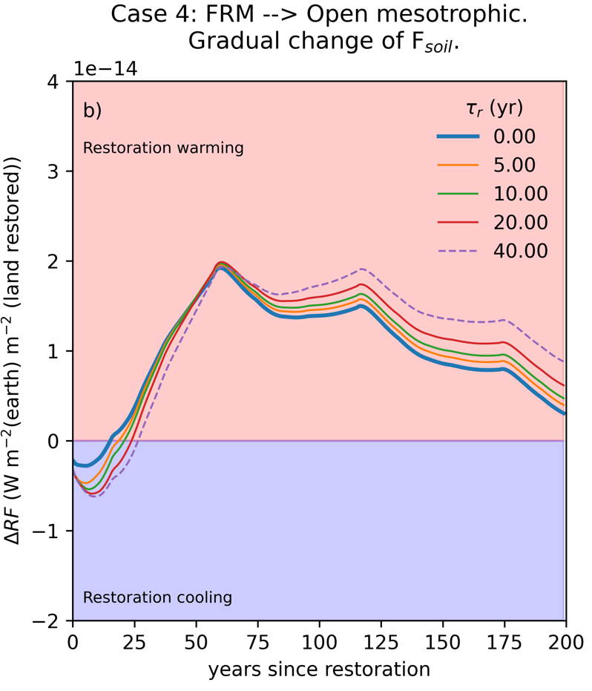
What if recovery takes time?
After rewetting hydrology recovers fast, other ecosystem functions gradually
Rate of soil GHG balance recovery is unknown, estimated to take 15 – 30 yr (Escobar et al. 2022)
Delayed recovery leads to more favorable short-term but more harmfull medium-term climate impact
Mainly due to gradual increase of CH₄ emissions

Slide 20
Key message
Should we restore?

Slide 21
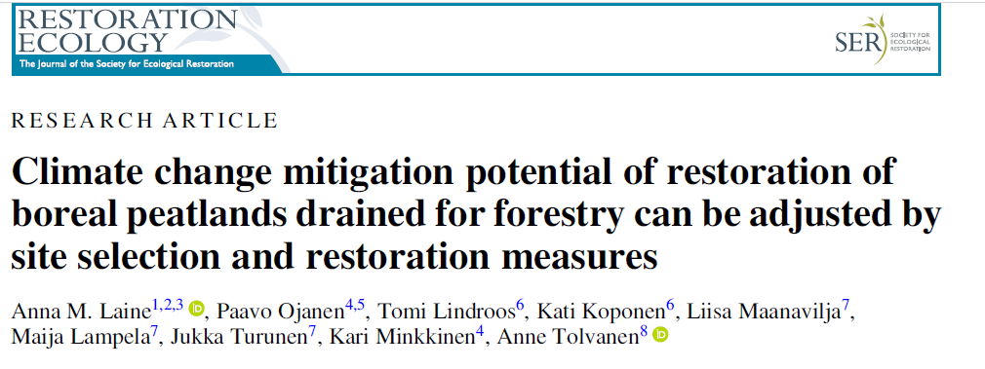
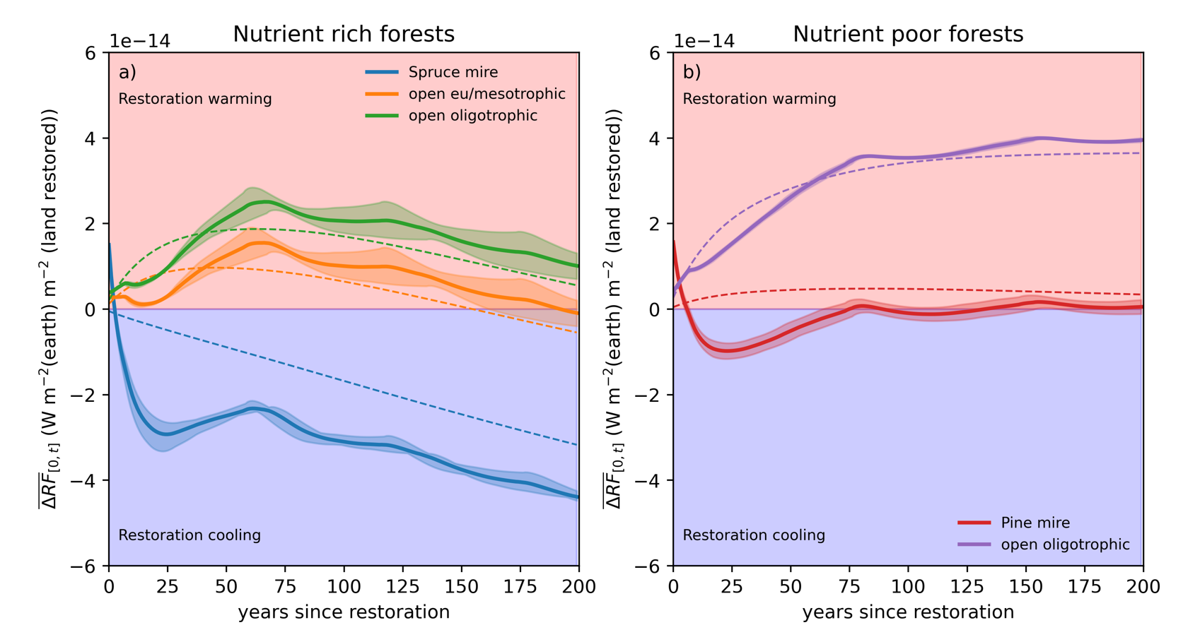
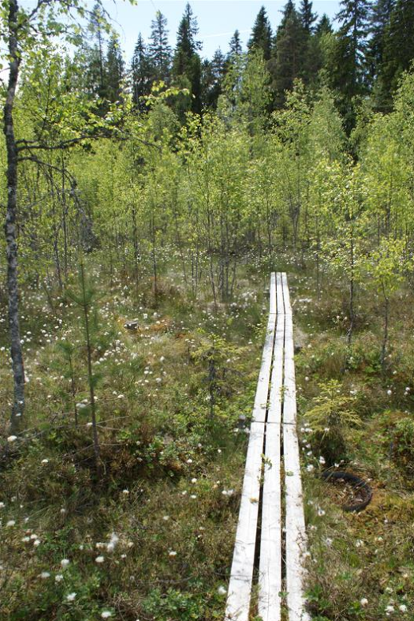
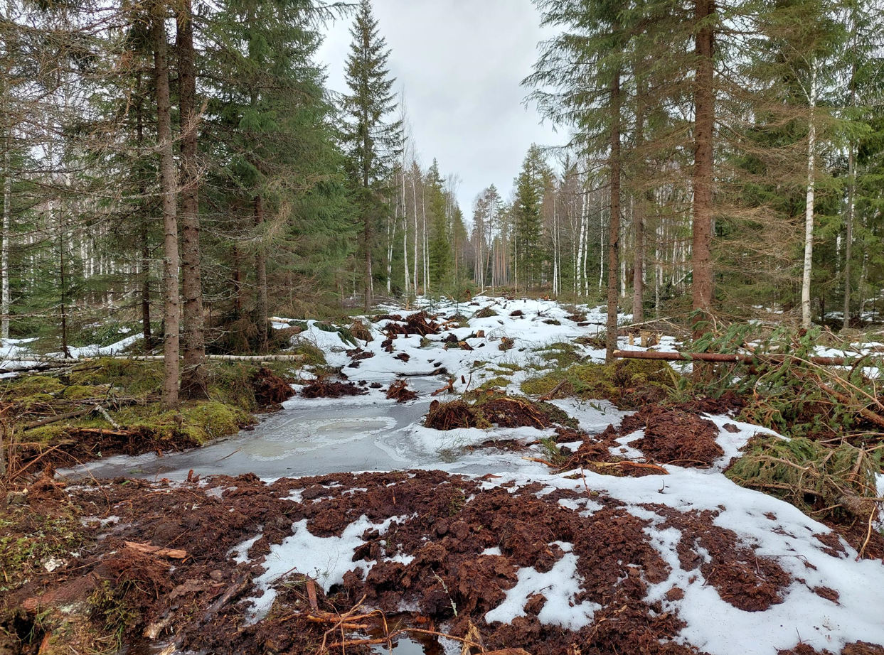
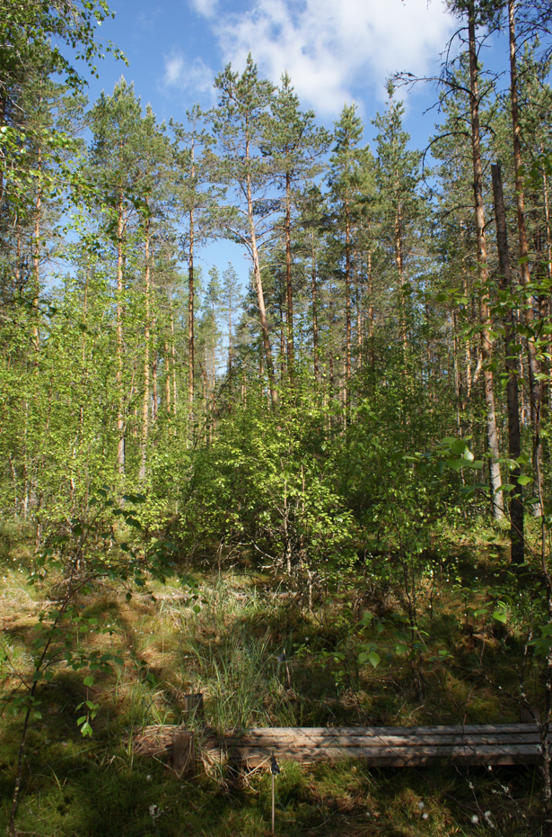
Climate impact dynamics of rewetting
No climate benefit except if successfully restoring nutrient rich stands to tree-covered mires

Slide 22
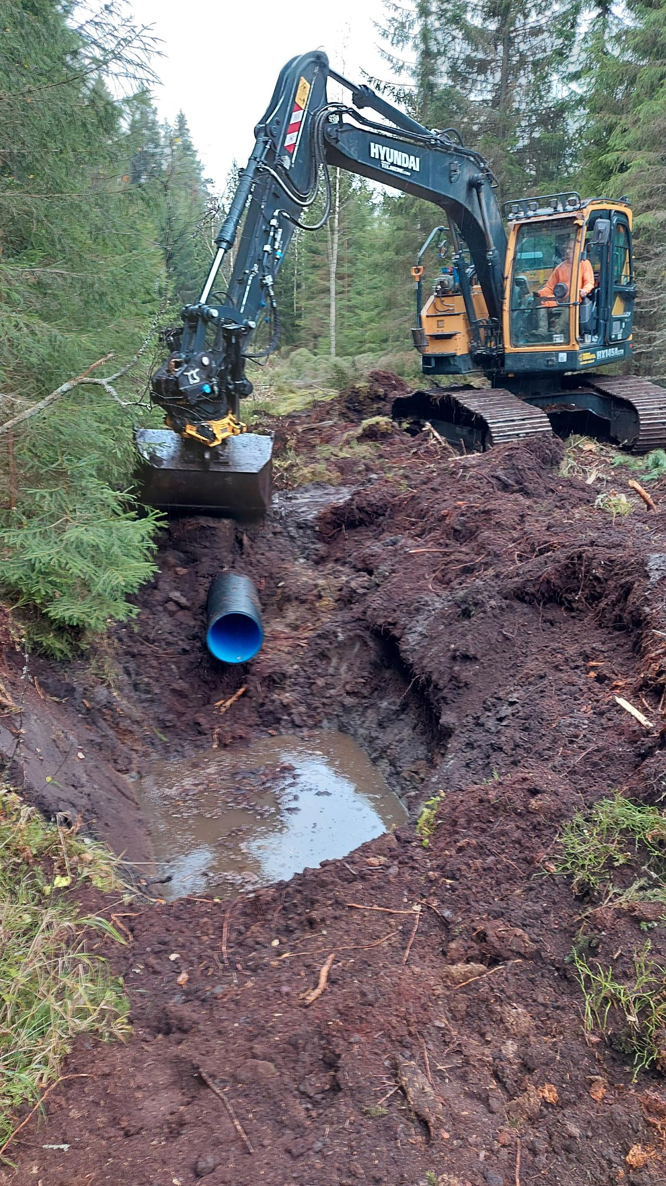
Should we rewet forest peatlands?
For ecological benefits & biodiversity
For improved water retention & natural hydrology
For better water quality?
For climate – not, except in a rare case when tree C storage is preserved
Climate impact of peatland use change can’t be assessed by CO₂ only
Restoration does not provide more of everything
Our results are by no means ground-breaking
Is knowledge respected?

Slide 23


Thanks! Contact: samuli.Launiainen@luke.fi
LS-Hydro (2023-2027): From forest structure to hydrological function – merging dense EO data and process-models
PREFER (2022-2026): Precision nutrient management - a tool for mitigation of climate change and environmental loading in boreal forestry
GreenFeedBack – Greenhouse gas fluxes and Earth system feedbacks

Slide 24
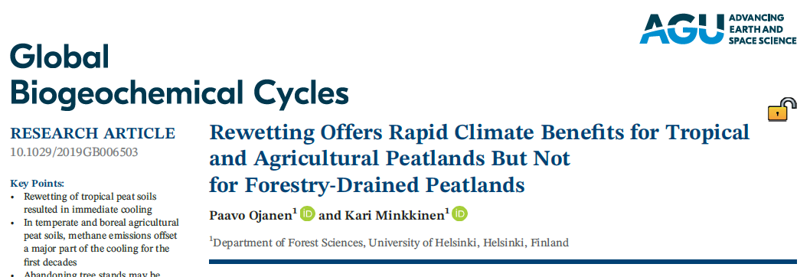
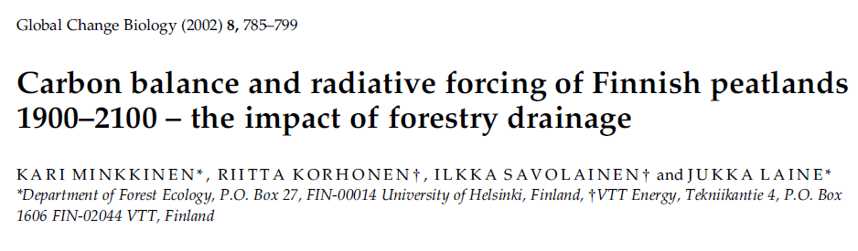
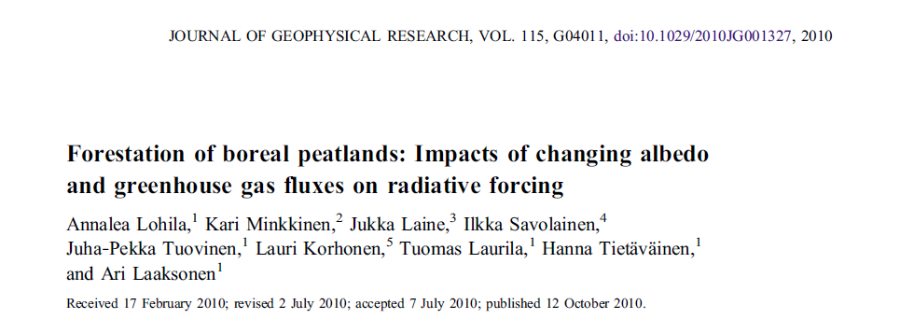
References
Escobar et al. 2022. Front. Env. Sci., doi: 10.3389/fenvs.2022.834371
Hynynen et al. 2005. For. Ecol. Manag., 207(1-2), pp.5-18.
Laine et al. 2024. Rest. Ecol., https://doi.org/10.1111/rec.14213
Launiainen et al. 2025. Ambio (in review), https://doi.org/10.31223/X5H43K
Lohila et al. 2010 J. Geophys. Res., doi:10.1029/2010JG001327
Peräkylä et al. 2025. Biogeosci., https://doi.org/10.5194/bg-22-153-2025
Ojanen, P. and Minkkinen, K., 2019. Mires and Peat, 24(Article 27), p.27.
Sarkkola et al. 2010. Can. J. For. Res. 40(8), pp.1485-1496.

